Slide 1

Impact of Fire Emissions on Air Quality, Respiratory Disease Incidence, and Healthcare Costs
Alexander He
alexwenzhenhe@gmail.com
hea2@rpi.edu
609-819-1937
Prof. Thilanka Munasinghe (Advisor)
thilankawillbe@gmail.com
munast@rpi.edu
857-998-8767
Rensselaer Polytechnic Institute
School of Science

Slide 2
Objectives
Utilize skills and knowledge from advanced Computer Science courses involving Machine Learning, Data Science, and Statistics
Perform analysis on fire emissions, air quality, and its human health impacts
Test the hypothesis:
Wildfires and other fire emissions contribute to higher concentrations of PM2.5 and emitted carbon, thus increasing the incidence/deaths and associated healthcare costs of respiratory diseases

Slide 3
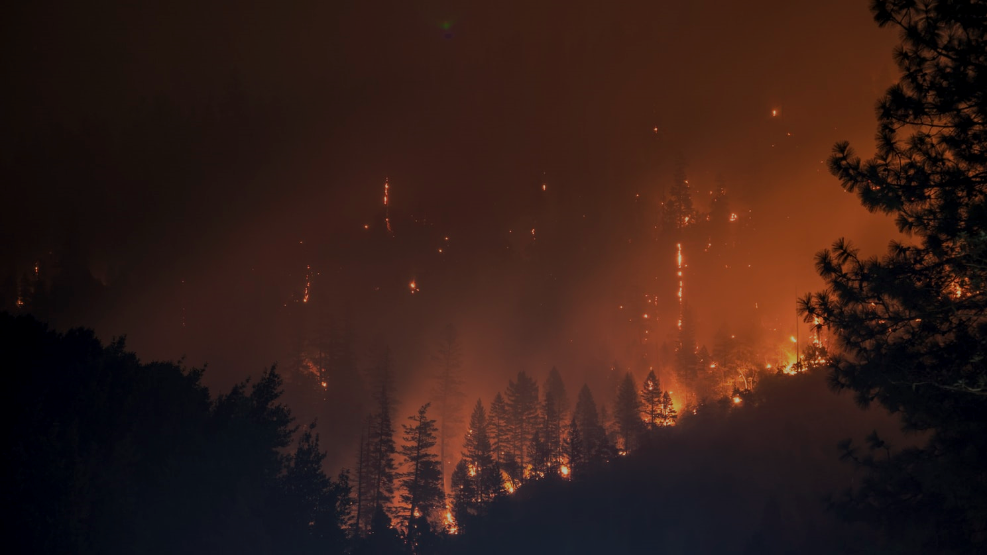

Background
Wildfires contribute significantly to fire emissions and pose imminent risks to human and ecosystem health
$PM_{2.5}, Ozone, and NO_{2}$ increases respiratory disease incidence/deaths, i.e. asthma, COPD, lung disease
Advances in satellite observations, chemical transport modeling, and ground-based monitoring give higher resolution and better-validated air quality indicator concentrations

Slide 4


Background
From 1997 to 2016, fire emissions increased surface 8-hour $O_{3}$ standard exceedances by 10% and 24-hour PM2.5 exceedances by 33% (contiguous U.S.)
Global mean carbon emissions: $2.2∗{10}^{15}$ grams of carbon per year ($Pg C/yr$) during 1997–2016
In 2015, 9-23 million global asthma ERVs were attributable to ozone, 5-10 million were attributable to PM2.5
Remote Sensing | Impact of Fire Emissions on U.S. Air Quality from 1997 to 2016–A Modeling Study in the Satellite Era (mdpi.com)
Global fire emissions estimates during 1997–2016 (copernicus.org)
Global Estimates and Long-Term Trends of Fine Particulate Matter Concentrations (1998–2018) | Environmental Science & Technology (acs.org)
Estimates of the Global Burden of Ambient PM2.5, Ozone, and NO2 on Asthma Incidence and Emergency Room Visits | Environmental Health Perspectives (nih.gov)

Slide 5
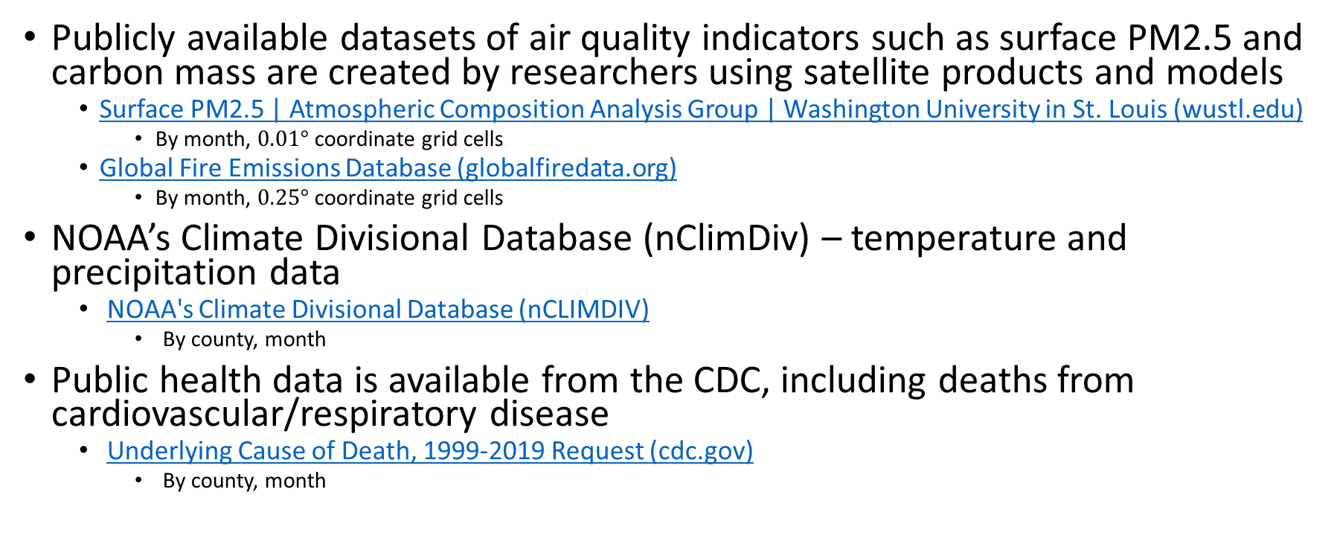
Datasets
Publicly available datasets of air quality indicators such as surface PM2.5 and carbon mass are created by researchers using satellite products and models
Surface PM2.5 | Atmospheric Composition Analysis Group | Washington University in St. Louis (wustl.edu)
By month, $0.01°$ coordinate grid cells
Global Fire Emissions Database (globalfiredata.org)
By month, $0.25°$ coordinate grid cells
NOAA’s Climate Divisional Database (nClimDiv) – temperature and precipitation data
NOAA's Climate Divisional Database (nCLIMDIV)
By county, month
Public health data is available from the CDC, including deaths from cardiovascular/respiratory disease
Underlying Cause of Death, 1999-2019 Request (cdc.gov)
By county, month

Slide 6
Datasets
US County shapefiles
Cartographic Boundary Files (census.gov)
Population data – yearly; monthly data estimated
County Intercensal Datasets: 2000-2010 (census.gov)
County Population Totals: 2010-2019 (census.gov)

Slide 7
Data wrangling
Web search of rich public datasets in the same timeframe
Create visualizations to understand the datasets (next 2 slides)
Prepare data for analysis
Organize all datasets into similar data structures/formats
Use of county shapefiles
Account for county changes since 2000
Total area of land and water (per county) to compute population densities
Aggregate grid cells by county to compute average air quality indicator concentrations

Slide 8
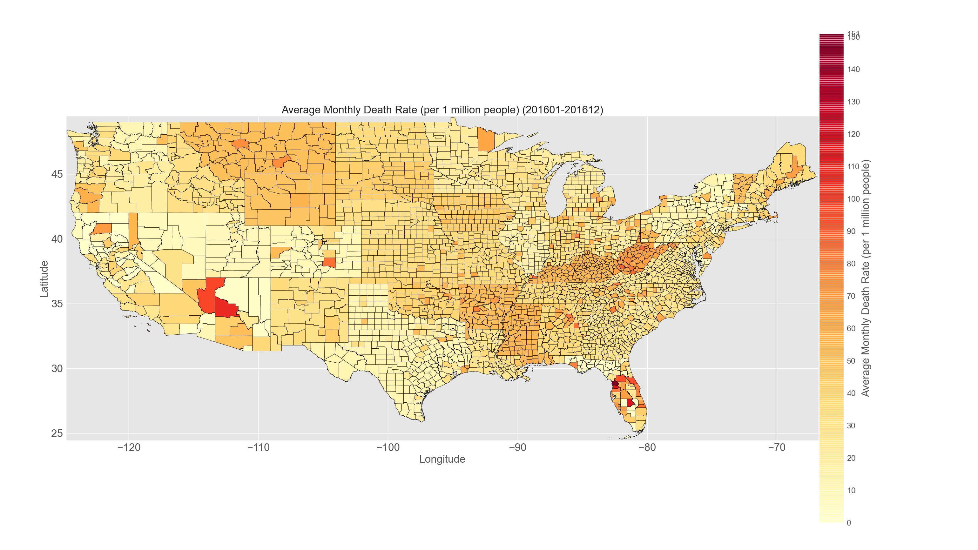
Average Monthly Death Rate from Respiratory Diseases
Research-Spring2021/code/plot_usa-outfiles/monthyDeathRate

Slide 9
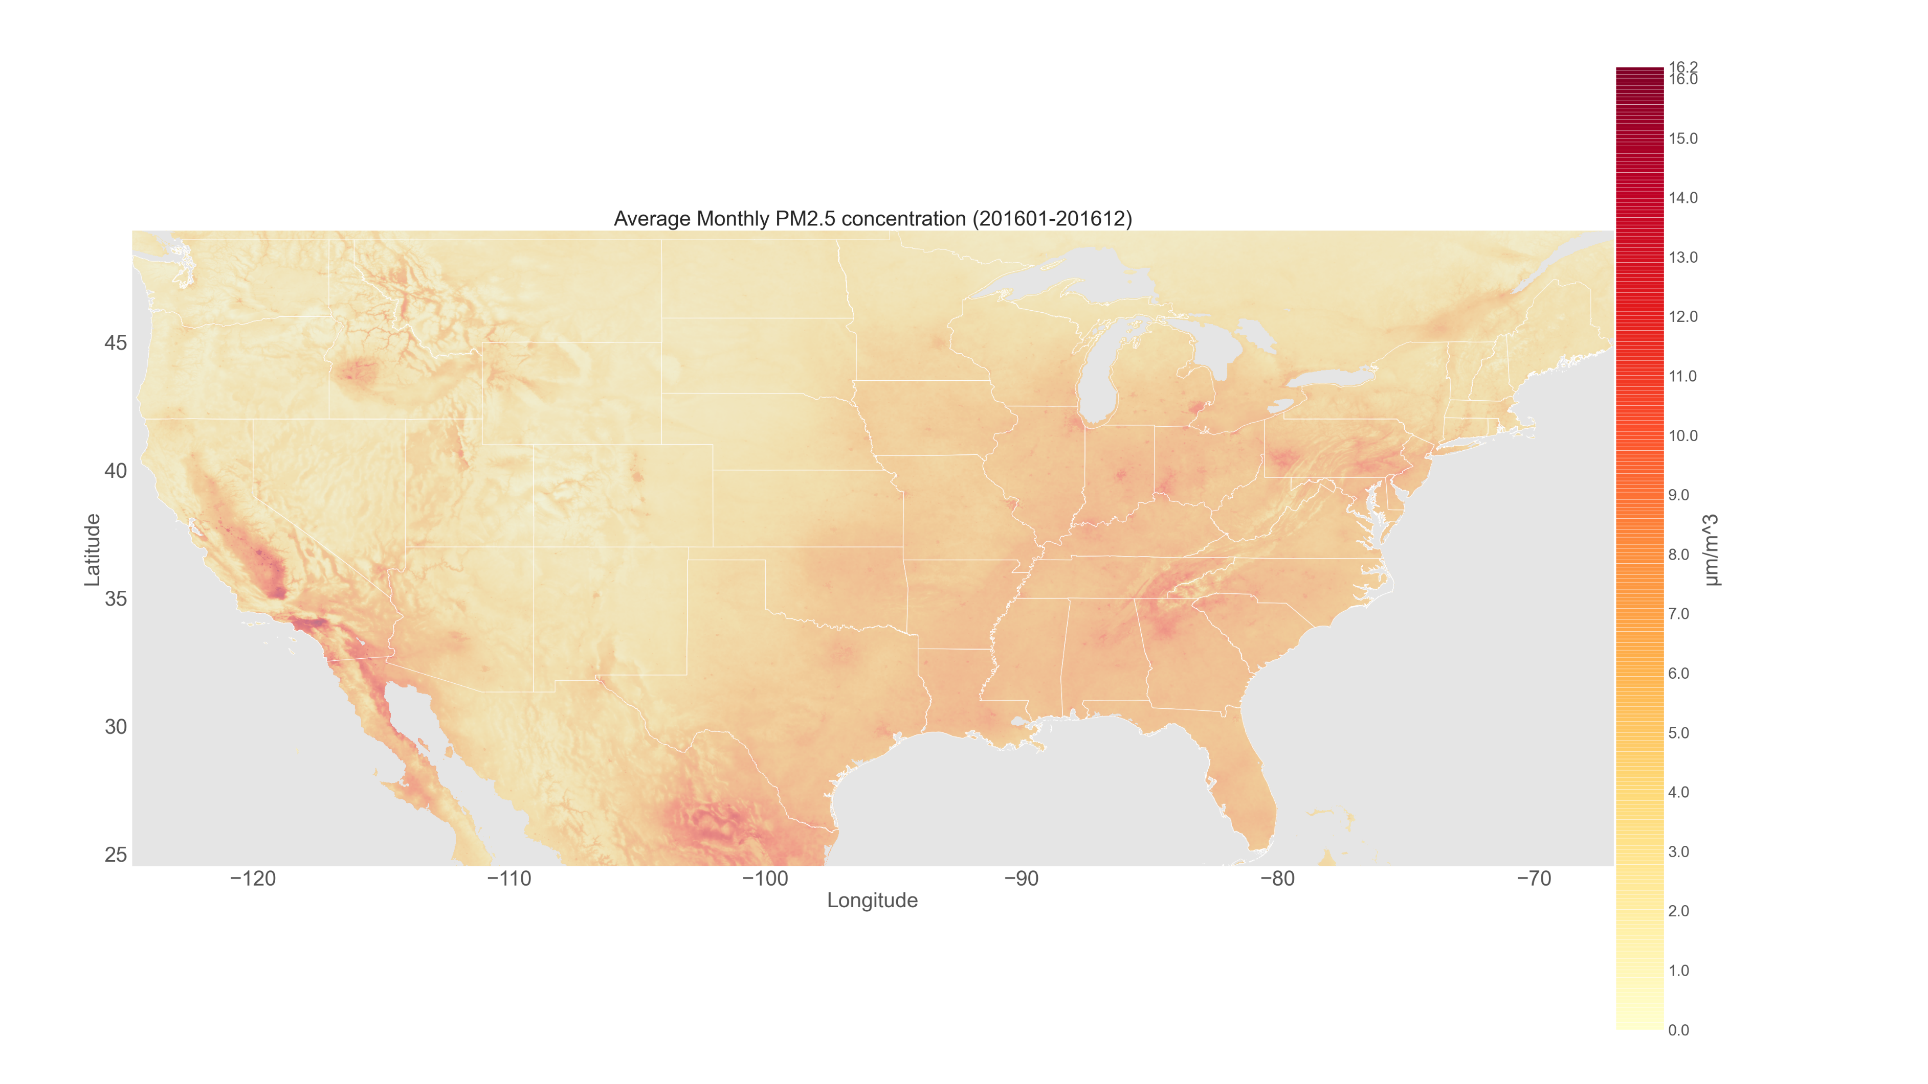

Average Monthly PM2.5 concentration ($μm/m^{3}$)
Research-Spring2021/code/read_acag_pm2-5-outfiles/TENA_2000-2018

Slide 10
Analysis (In-Progress)
Clustering to identify isolated/recurrent hotspots of PM2.5, carbon emissions
Grid density-based algorithms: ST-GRID, CLIQUE
subspace (R package), PyClustering
Multivariate analysis between air quality/emission indicators, disease incidence, temperature, precipitation
PCA, Bayesian inference, spatial autocorrelation, Monte Carlo tests
Random forest regression to rank the importance of variables
Predictive power for disease incidence as the target variable
RandomForestRegressor (scikit-learn package)
Measure seasonal patterns
Changes in indicator concentrations, death counts
Differences in correlations and predictive power

